Slide 1

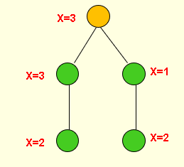
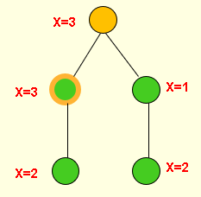
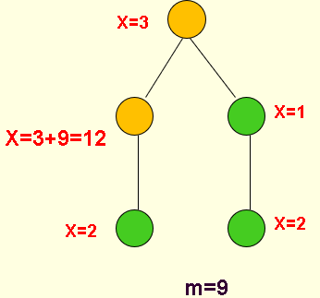
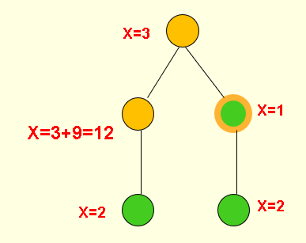
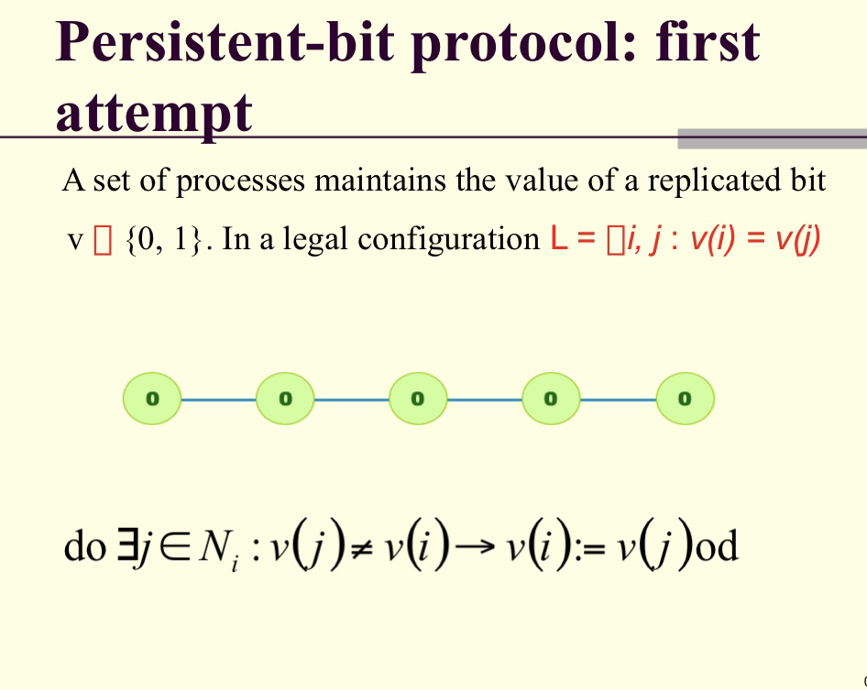
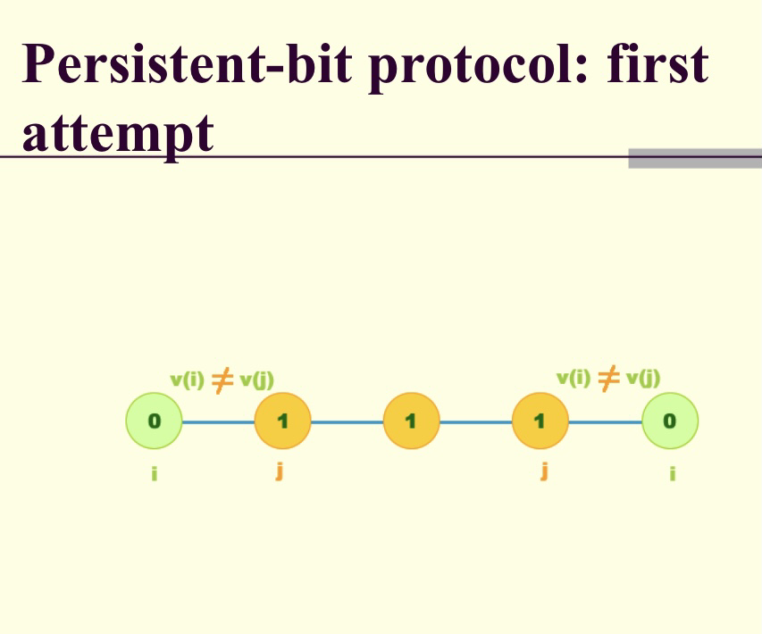
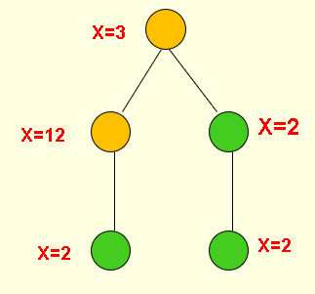
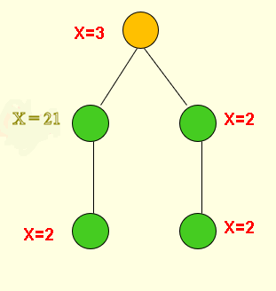
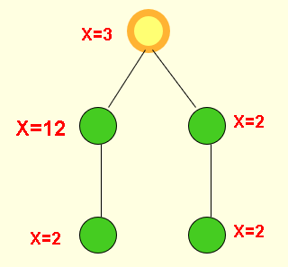
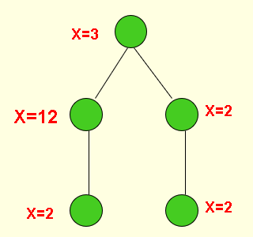
Background:
A distributed system is self-stabilizing, when starting from an arbitrary initial configuration, the system returns to a legitimate configuration in a bounded number of steps and remains in that configuration thereafter. Such arbitrary configurations may be caused by transient failures that can corrupt the system state.
In most well-designed systems, the possibility of a massive failure is miniscule, and single failures are much more likely to occur.
To increase the efficiency of fault-tolerance, it is important to guarantee a much faster recovery from all single failures, while also guaranteeing eventual recovery from more major failures.
The problem of containing the effect of minor failures is becoming important not only because they are more likely to occur, but also due to the dramatic growth of network sizes.
In most self-stabilizing systems, a single transient failure can potentially contaminate a large portion of the system.
The tight containment of the effect of single failures depends on the context: containment in time implies that all observable variables of the system recover to their legitimate values in O(1) time, whereas containment in space means that the processes at O(1) distance from the faulty process make observable changes. For optimal performance, both of these properties should hold.
Simulation Experiments of a Distributed Fault Containment Algorithm Using Randomized Scheduler
By David Kingsley Tan
Faculty Sponsor: Dr. Anurag Dasgupta
Abstract:
Fault containment is an important feature of stabilizing distributed systems. A distributed system is stabilizing if there exists a finite sequence of moves that leads to a legal configuration. Generally, a distributed system will stay in a stabilizing state once it reaches that configuration unless there is a fault. The probability of a massive failure is very low, and a single fault is more likely to occur compared to multiple failures. Containing single failure is more important in distributed systems because of the improvement of system reliability. The fault containment algorithm we implemented helped restore the legitimate configurations of the system from any state. This paper presents some simulation experiments we have performed in single fault scenarios using a randomized scheduler. The simulation results give an insight into the efficiency of our algorithms. Variations in the number of nodes and the degree of faulty node are some of the factors that have been considered in the experiments, and they were graphically and numerically analyzed to provide useful information.
Results:
Trend for Average Time
Trend for Deviation of Degrees
Algorithm and Examples:
Process i updates v(i) when the following three conditions hold
a) The randomized scheduler chooses i
b)
c)
The corresponding action also increases x(i) to max {x(j) : j ∈ N_{i} } + m, (m>0)
Persistent-bit protocol Solution:
Persistent bit problem is not stabilizing with a single variable. That is why we introduced a secondary variable x in our solution.
2. All three conditions are true, so it changes from green to orange
3. And we assume m=9 in this example, so x becomes 12 for that node (x= x+m)
4. If the node with x = 1 is chosen, there the first two conditions hold. So, x value will be increased to 2 but its color stays the same
1. Green node x=3 is being triggered
Conclusion:
Our algorithm restricts the single fault to only its 1-distance neighbors with high probability [1]. We ran simulation experiments to evaluate the effectiveness of our algorithm. We used different parameters to see how those with variations affect the stabilization time of the network. We ran simulations with variable network size, different degrees of the nodes (sparse and dense graphs), changing the faulty node’s location etc. Along with creating an algorithm, we created a random graph generator and a random scheduler to record the time within the fault gap and to see how long it took the fault to recover thus achieving stabilization.
5. Now if the scheduler chooses the node with x= 12, again all three conditions are true for the node.
6. So, it changes to green and x becomes 21
7. Recovery completes when ∀j ∈ N_{i} : v(i) ≠ v(j) and the scheduler selects i.
Node i flips v(i) regardless of the value of x(i)
8. So, at this point if the top most node is chosen, it turns to green and the system stabilizes.
Future Work:
The above algorithm is an extension of the persistent bit protocol solution [2, 3]. There are other fault containment algorithms [4] of similar type and in the future, we want to conduct simulation experiments for those too. We will also explore the conditions in different topologies like ring, tree, star etc. This research was supported by the Blazer Summer Research Institute at Valdosta State University.
References:
Probabilistic Fault-Containment. A. Dasgupta, S. Ghosh, X. Xiao, SSS 2007: 189-203.
Fault-local distributed mending. S. Kutten, D. Peleg. in: Proc. 14th Annu. ACM Symp. on Principles of Distributed Computing, August 1995.
Stabilizing time-adaptive protocols. S. Kutten, B. Patt-Shamir. Theor. Comput. Sci. 220, 93-111 (1999).
Fault Containment in weakly stabilizing systms. A. Dasgupta, S. Gosh, X. Xiao. Theor. Computer. Sci. 412(33): 4297-4311 (2011).

